Slide 1
Data Science Jobs in the DC Area
Why DC is a great area for the field of data science.
General Assembly
Jan. 2017
Philip Bradfield

Slide 2
Use information from Indeed.com to find:
Median Salary for the DC Area
Factors Impacting Pay
Skills & Key Words

Slide 3
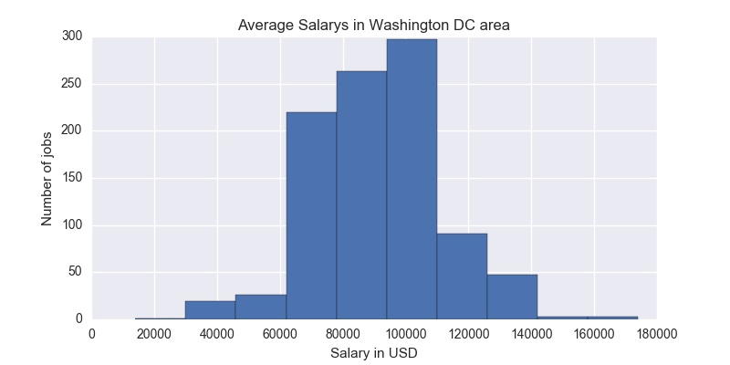

Slide 4
Considered a range of ‘data’ science job types over the general DC area: $91,000

Slide 5
Factors of Importance for higher pay:
Job titles: “Data Analyst”, “Research Analyst”
“Program Analyst”
Locations: Washington DC, Lexington Park MD
Springfield VA
Company Name: Booz Allen

Slide 6
Skills: Excel, SQL, Python, Hadoop,Java, NoSQL, SAS, ( C++)
Key Words: “Experience” , “Security” & “Clearance”, “Degree” & “BS”, “Years of Experience”

Slide 7
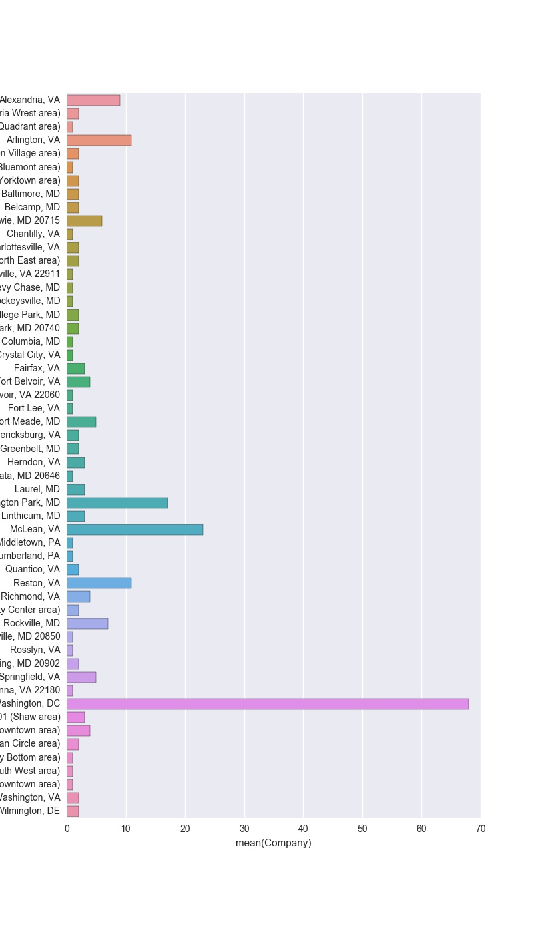
“Data” jobs in Cities in DC region
Cities in the DC region with the most job postings.
Washington DC
McLean VA
Lexington Park MD
Reston VA
Arlington VA
Alexandria

Slide 8
Conclusion:
Median Salary:$91,000
#1 Factor: Job Title:Data Analyst
#1 Location: Washington DC
Skills & Key Words: Excel, SQL,Python,Hadoop,Java,NoSQL

Slide 9
regex = r"(?<=Qualifications:)(.*?)(?=variable)”
regex = r"(?<=Qualifications:)(.*?)(?= {0})".format(variable)

